Slide 1
INTERACTIVE VIDEO PPT
Presented By
Shradha Matte

Slide 2
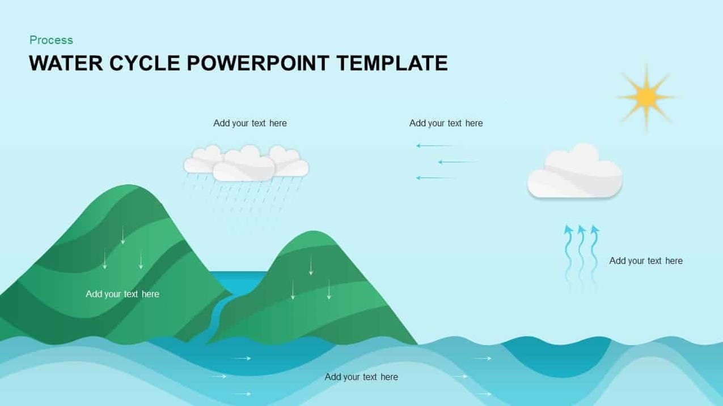

condensation
Rain
Evaporation
River

